Slide 1
Take the Pain out of Database Migrations
Chris Lumnah
SQL Server Solutions Architect

Slide 2

Who am I?
SQL Server Solutions Architect with Rubrik Inc.
Over 15 years of experience as a Production Database Administrator
Use Powershell to help automate everything
Started career as a developer
Prefer spaces over tabs

Slide 3
Agenda
Why migrate?
The checklist
Discovery
Migration work prep
What to do a week before the migration
What to do the day of the migration

Slide 4
Rubrik Fits any SQL Server Environment
Protects any SQL Server database – physical or virtual
Works with Always On Availability Groups and SQL Failover Cluster Instances
Supports Database Log Shipping
Supports SQL Server 2008 to 2019 on Windows
All SQL Server Features supported (including TDE, Filestream, In Memory OLTP, SQL Replication)
Archives to any cloud

Slide 5

Why Migrate?
Aging, no longer supported hardware
Unsupported OS
Unsupported Database platform
Take advantage of the new features
Business reasons
New application requirements
Notes:
Most people running SQL 2005 are also running Windows 2003. Windows 2003 fell out of support in July of 2015. SQL 2005 is officially EOL as of April of 2016. This set up is also sitting on hardware that is beyond the intended life cycle.
Maybe you want to take advantage of features like
AlwaysOn
Columnstore indexes
Buffer pool extensions
In memory OLTP
AlwaysEncrypted
Stretch Database
Power BI

Slide 6
The Checklist
4 major areas of checklist
Should be broad enough to cover every condition in environment
Should be a living document
Should be applicable to single database or all databases on a server

Slide 7
4 areas of the checklist
Discovery
Migration Preparation
Migration Week
Migration Day

Slide 8

Discovery
Identify Servers, Databases, and Owners
Supporting database objects
Special configuration considerations
Storage requirements
Enterprise features in use
Notes:
Supporting database objects
DTS/SSIS Packages
Logins
Jobs
Linked servers
DNS Entries
Special configuration considerations
MAXDOP
DTC
Security
Firewall rules
Use of SA
Collation
Third party drivers required to be installed on the SQL Server
https://msdn.microsoft.com/en-us/library/cc280724.aspx SELECT feature_name FROM sys.dm_db_persisted_sku_features

Slide 9

Migration Prep
Run the Upgrade Advisor
Review and reduce current database security requirements where appropriate
Determine HA requirements
Work with dev teams to assist in migration work direction
Get new servers prepped
Notes:
Running the Upgrade Advisor will provide results of potential database problems that should be resolved before the migration. The items on this list are generally done by the development teams. I also run this to have it show that in most cases, no changes are required by dev teams or non-technical staff. This can help alleviate some of their stress of having to take on a huge amount of work.
Reducing the security requirements is all about making sure that least privilege required model is being followed. It is also about cleaning up old stale logins that are no longer being used.
HA Requirements will help in the decision process of AG vs WSFC. If DTC is required then AG is not a good idea as this is not supported in current versions of SQL. If DTC is not required, how many groups are required? This in turn will require a new IP per each group.
Part of this prep is also making sure that servers are built up to standards.

Slide 10

Migration Week
Move database supporting objects
Create Availability Groups
Create firewall rules from other servers to SQL Server
Seed large databases with full backup restores
Dry run test
Notes:
This week should also be used to prep full backups of large databases. These databases take a long time to backup and restore. This type of work can be done during the migration week to help minimize downtime during the migration day. These backups can also be used to facilitate the dry run testing. Taking a full backup earlier in the week, allows for the final backup to be a differential and logs later.
Log shipping could also be used to help minimize the downtime on migration day.
Sp_helprevlogin: https://support.microsoft.com/en-us/kb/918992

Slide 11
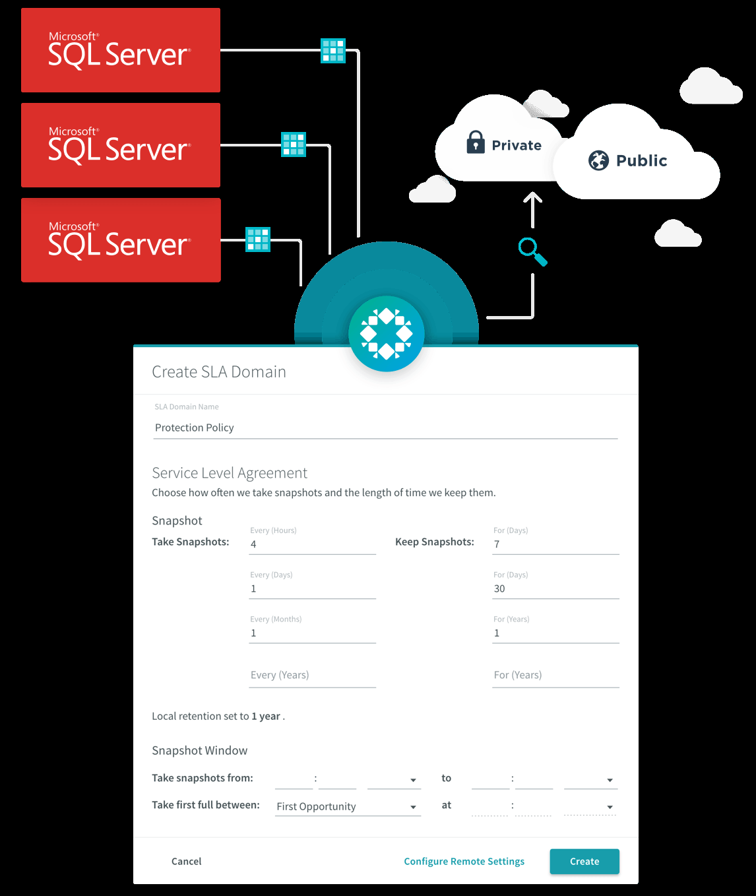
How does Rubrik Help?
Rubrik Log Shipping to stage your database
Rubrik SDKs to script out migration tasks
Powershell scripts on Github to help with migration tasks
Combine with T-SQL Scripts to create a smooth migration
Notes:
https://gateway.on24.com/wcc/eh/2256824/lp/2310928/operationalize-your-sql-server-backups-with-rubrik/
https://gateway.on24.com/wcc/eh/2256824/lp/2310876/an-introduction-to-rubrik-for-backup-administrators%2C-dbas-and-architects/
https://gateway.on24.com/wcc/eh/2256824/lp/2310775/orchestrate-and-automate-with-rubrik-powershell/
https://github.com/rubrikinc/rubrik-sdk-for-powershell
https://github.com/rubrikinc/rubrik-scripts-for-powershell

Slide 12

Migration Day
Freeze database from any further transactions
Take final backups and take databases offline
Bring databases online on new server
Run post upgrade scripts
Notes:
Migration Day Process
Set databases read only on old server
Take the final backup
Set the databases offline on the old server
Restore the databases on the new server
Make them writeable
Reset the security in the new databases
Run Post upgrade scripts
Set the owner of the database to standard
Set the compatibility level
Run DBCC UPDATEUSAGE against database
Run DBCC CHECKDB WITH DATA PURITY against database
Rebuild all indexes
Recompile all stored procedures
Add databases to appropriate availability groups

Slide 13

After the Migration....
"Everyone has a plan 'till they get punched in the mouth." - Mike Tyson
Have a post-modem.
What went well?
What didn’t go well?
Update the checklist.

Slide 14

The ways to remove the pain...
In Summary
Create your check list
Document everything
Communicate clearly and often with the owners of the databases
Automate
Learn from the last migration
Notes:
Automation
Chrissy Lemaire, SQL MVP from Belgium wrote Powershell scripts to help simplify migration tasks https://blog.netnerds.net/2015/05/simplifying-sql-server-migrations-using-powershell/

Slide 15






Questions
chris.lumnah@rubrik.com
chrislumnah.com
@lumnah
clumnah
lumnah
Notes:
www.linkedin.com/in/lumnah

